Slide 1
Unity3d引擎发展史
CylonSpace 2017.1
Notes:
VR/AR应用开发的基本流程

Slide 2
日程
Unity3d引擎发展史
Unity3d Roadmap
使用Unity3d开发的代表作品

Slide 3
Unity3d引擎发展史

Slide 4
David Helgason(CEO, Right) Nicholas Francis(COO, Middle) Joachim Ante(CTO, Left)
Unity创始人

Slide 5
August 2, 2004 Copenhagen ,Danmark
Unity创办

Slide 6
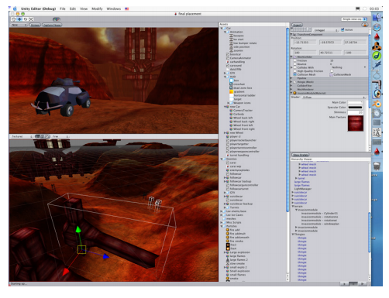
Version 0.2b,
Unity版本的 重要里程碑- Version 0.2b

Slide 7
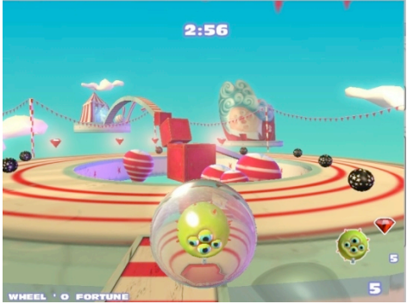
Only Mac OS X supported
Unity版本的 重要里程碑- Version 1.0
Version 1.0, Jan 2005

Slide 8
Unity版本的 重要里程碑- Version 1.5
Runner-up for Best Use of Mac OS X
2006 WWDC

Slide 9
Unity版本的 重要里程碑- Version 2.0
Oct 2007,Unite Developer Conference Support Microsoft DirectX, OpenGL, Vista
Support web streaming, Unity Asset Server, networking

Slide 10
Unity版本的 重要里程碑- Unity iPhone
Released in Dec, 2008,

Slide 11
Released in 2009 Game Developers Conference Windows Support Added Support for external C/C++ Plugins
Unity版本的 重要里程碑- Version 2.5

Slide 12
Released in Sep 27,2010 Features: editor unification, Beast lightmapping, deferred rendering, Umbra occlusion culling, low level debugging, and FMOD audio filters 200,000 registered Unity developers No.1 engine for educational apps
Unity版本的 重要里程碑- Version 3.0

Slide 13
Released in Feb 14,2012 Features: Support for Flash development
Unity版本的 重要里程碑- Version 3.5

Slide 14
Released in Nov 13,2012 Features: Mechanim animation, Linux publishing, Shuriken particle system
Unity版本的 重要里程碑- Version 4.0

Slide 15
Released in Nov 12,2013 Features: 2D support
Unity版本的 重要里程碑- Version 4.3

Slide 16
Released in Nov 20,2014 Features: Native UI
Unity版本的 重要里程碑- Version 4.6

Slide 17
Released in Mar,2015 Features: PBS, Realtime GL, Physx3.3
Unity版本的 重要里程碑- Version 5.0

Slide 18
Released in Jun,2016 Features: VR native
Unity版本的 重要里程碑- Version 5.4

Slide 19
Released in Nov,2016 Features: HoloLens support
Unity版本的 重要里程碑- Version 5.5

Slide 20
Unity3d引擎Roadmap

Slide 21
Released in Mar,2017 Features: Google Daydream VR support
Unity Version 5.6

Slide 22
Release Date uncertain Features: Nintendo Switch support, Apple Watch Compatibility, WebVR support,
Unity Version 5.x

Slide 23
https://unity3d.com/unity/roadmap
更多Roadmap

Slide 24
使用Unity3d开发的代表作品

Slide 25
炉石传说

Slide 26
Angry Birds2

Slide 27
Super Mario Run

Slide 28
Pokemon Go

Slide 29
新仙剑奇侠传

Slide 30
轩辕剑6

Slide 31
https://madewith.unity.com/ https://unity3d.com/showcase/gallery https://en.wikipedia.org/wiki/List_of_Unity_games
更多 Unity3d游戏

Slide 32
1.阅读Unity3d的最新roadmap，了解未来版本的特性 2.在网上搜索，下载并体验5款使用Unity3d开发的游戏
作业

Slide 33
Thank you
Virtual reality makes a better reality.

